Slide 1

pickup
no scrubs allowed
Front-End
Jimmie Jackson
Ben Arteaga
Back-End
Derrick Suarez
Royce Ching

Slide 2
pickup
Create & Find Pickup Games for Sports
Basketball
Soccer
Disc Golf
Schedules & Provides
Pickup Games
Date, Time, Location & Maps
Weather Updates
pickup

Slide 3

Concept & Development
Brainstorming
Ability to meet project requirements
Two API’s
AJAX to pull data
Firebase
Polished Front-End / UI
Bootstrap or Alternative CSS Framework
User Validation
pickup

Slide 4

Design Process
NOTE:
To change images on this slide, select a picture and delete it. Then click the Insert Picture icon
in the placeholder to insert your own image.
Establishing Roles
Front-End / Back-End
Project Management / Assigning Tasks
UI / CSS / Homepage
Data management / Firebase
API Development
Google Maps
Weather
Overall Website Structure
Specialty Features
pickup

Slide 5
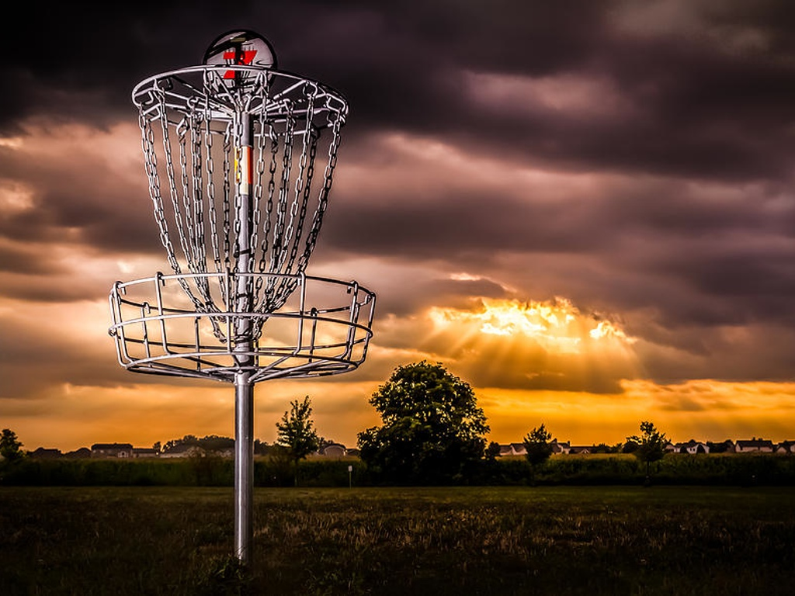
Technologies
Bootstrap
jQuery
Firebase
AJAX
Google Maps API
Weather Underground API
Validation Functions
Vex Modals
pickup

Slide 6
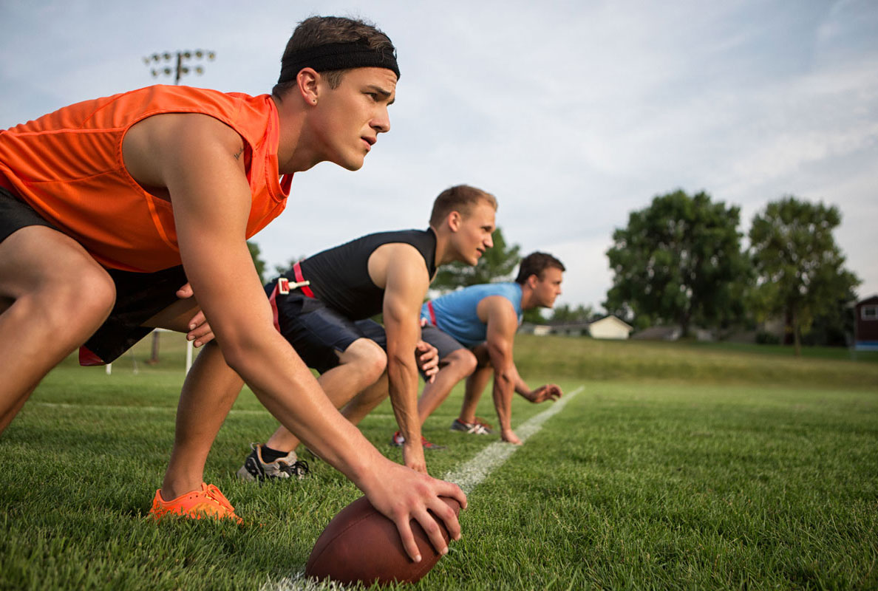
Demonstration
Heroku
pickup

Slide 7

Future Development
Facebook / Google Login
Expand Locations
Personalized Pickup Games
Calendar Integration
Mobile / Text / SMS Alerts
Email Alerts
pickup

Slide 8
Questions?
pickup

